Slide 1
COMPUTATIONAL MEDICINE
Brain Tumour Surgical Planning for High Grade Glioma
Andruga Seth Silver | 2026/MBME/001/PS

Slide 2
INTRODUCTION: |
Dynamics of Surgical Planning
High Grade Glioma Diagnosis
Irregular tumour progression patterns
Tumour cells can infiltrate brain tissue beyond observable with conventional MRI
Neurosurgical team must establish tumour extent and determine amount of tissue removable without causing significant neurological impairment.
COMPUTATIONAL MEDICINE | HIGH GRADE GLIOMA SURGICAL PLANNING

Slide 3
INTRODUCTION: |
MRI Suitability and Pitfalls
Visualize details of tumour anatomy, tissue characteristics, vascularity without invasive procedure.
MRI + AI/ML techniques supports delineation of tumour regions, computes volume and quantitative feature extraction that support surgical planning.
Only suggests presence of glioma but not definitive establishment of histological and molecular diagnosis.
Insufficient for examination of Gliobastoma, IDH-wildtype diffuse gliomas.
COMPUTATIONAL MEDICINE | HIGH GRADE GLIOMA SURGICAL PLANNING

Slide 4
INTRODUCTION: |
Adopted Workflow
Biological sampling and diagnostic investigations.
Conventional MRI imaging and examination
Medica Image processing [Tumour segmentation and Quantitative feature extraction]
Segmentation & Feature extraction Data Source:
Medical Segmentation Decathlon, “Task01_BrainTumour” from Hugging Face derived from BraTs (Brain Tumour Segmentation) research data
COMPUTATIONAL MEDICINE | HIGH GRADE GLIOMA SURGICAL PLANNING

Slide 5
STEP ONE: |
Biological Samples
Brain Tissue Biopsy
Stereotactic Needle Biopsy:
Small tissue sample obtained using needle guided by pre-operative CT or MRI.
Used when tumour is located in deep brain structures e.g. thalamus, where extensive surgical removal is more risky.
Limitation:
High-grade gliomas are heterogenous; small sample tissue gives limited information.
COMPUTATIONAL MEDICINE | HIGH GRADE GLIOMA SURGICAL PLANNING

Slide 6
STEP ONE: |
Biological Samples
Brain Tissue Biopsy
Surgical Resection Specimen:
Obtain as much tissue as can be safely achieved, for examination.
More sample for comprehensive diagnosis.
Limitation:
Obtaining large portions of brain tissue potentially impairs neurological function.
COMPUTATIONAL MEDICINE | HIGH GRADE GLIOMA SURGICAL PLANNING

Slide 7
STEP ONE: |
Histopathological Examination
Process & Pathological Feature Identification
Process:
Tissue embedded in Paraffin, stained with Haematoxylin & Eosin, then examined under Microscopy.
Feature Identification:
Increased cellularity.
Nuclear atypia & Cellular pleomorphism
Increased mitotic activity
Microvascular proliferation
Areas of tumour necrosis
World Health Organization [WHO] Recommendation:
Diagnosis of CNS tumours must place considerable emphasis on molecular & histological characteristics.
COMPUTATIONAL MEDICINE | HIGH GRADE GLIOMA SURGICAL PLANNING

Slide 8
MRI Imaging Features for Treatment Outcome Predictions
STEP TWO: |
MRI guides in examining Tumour extent, Tissue infiltration and mapping removal tissue during surgery.
Conventional and Advanced MRI is employed.
Conventional MRI features:
T1-weighted contrast enhanced imaging: helps estimate visible tumour.
T2-weighted imaging: Provides info about tissue surrounding the tumour.
Fluid-Attenuated Inversion Recovery[FLAIR]: Visualization of peritumoral hyperintensity
Diffusion-Weighted Imaging[DWI] & Apparent Diffusion Coefficient [ADC]:
- DWI: Measures movement of water molecules within tissue
- ADC: Provides info about water diffusion.
- Regions with dense tumour restrict diffusion.
COMPUTATIONAL MEDICINE | HIGH GRADE GLIOMA SURGICAL PLANNING

Slide 9
MRI Imaging Features for Treatment Outcome Predictions
STEP TWO: |
Advanced MRI techniques:
Magnetic Resonance Spectroscopy: Examines chemical composition of tissues
Diffusion Tensor Imaging and Functional MRI: Determine safest surgical method and extent of resection without unacceptable neurological damage.
COMPUTATIONAL MEDICINE | HIGH GRADE GLIOMA SURGICAL PLANNING

Slide 10
MRI Imaging Features for Treatment Outcome Predictions
STEP TWO: |
MRI features Associated with treatment outcomes:
Feature | Relation with Outcome | Relevance to planning
Total tumour volume | Large tumour ≈ Poor prognosis & Treatment complexity | Estimates overall extent of disease.
Enhancing Tumour Volume | Reflects volume of contrast enhancing abnormality | Quantify visible tumour burden
Necrotic fraction | Proportion of tumour core with necrotic/dead tissue. | Characterizes tumour heterogeneity.
FLAIR Abnormality Volume | Reveals oedema and Infiltrative tumour beyond enhanced region | Reveals wider extent of abnormal tissue.
COMPUTATIONAL MEDICINE | HIGH GRADE GLIOMA SURGICAL PLANNING

Slide 11
MRI Imaging Features for Treatment Outcome Predictions
STEP TWO: |
MRI features Associated with treatment outcomes:
Feature | Relation with Outcome | Relevance to planning
ADC Values | Low ADC ≈ Increased cellularity | Shows regions with different tissue characteristics.
Relative Cerebral Blood Volume [rCBV] | Increased values ≈ Angiogenesis and Vascularity | Shows biologically active tumour tissue
Tumour Location | Tumours in critical regions restrict surgical resection | Assessment of surgical accessibility and functional risk.
Residual Tumour Volume | Greater post-operative residual tumour ≈ poorer outcomes | Assesses effectiveness of resection.
COMPUTATIONAL MEDICINE | HIGH GRADE GLIOMA SURGICAL PLANNING

Slide 12
Image Segmentation and Feature Extraction
STEP THREE: |
Image Data Source:
BraTs: Medical Segmentation Decathlon (MSD), Task01: Brain Tumours
Programming Languages Employed:
Python, R
Packages:
Python (nibabel, numpy, pandas, matplotlib, scipy, scikit-learn, scikit-image) R(readr, ggplot2, dplyr, tidyr)
COMPUTATIONAL MEDICINE | HIGH GRADE GLIOMA SURGICAL PLANNING

Slide 13
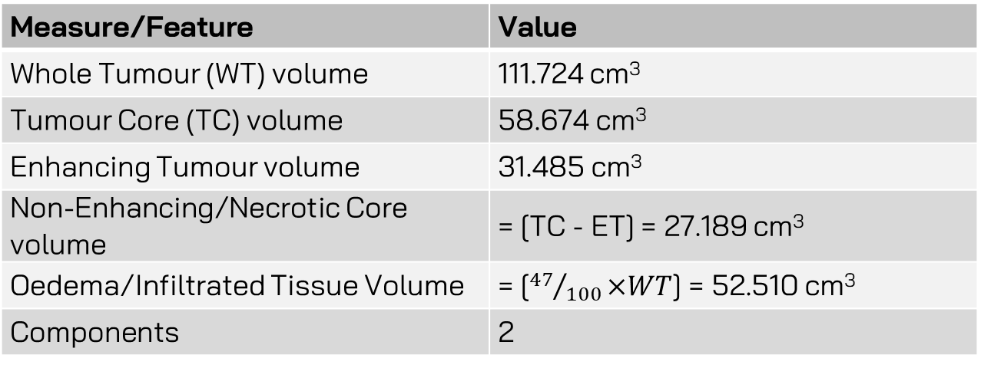
Image Segmentation and Feature Extraction
STEP THREE: |
Considering image BraTs_001.nii.gz: Extracted Sample Features
Measure/Feature | Value
Whole Tumour (WT) volume | 111.724 cm³
Tumour Core (TC) volume | 58.674 cm³
Enhancing Tumour volume | 31.485 cm³
Non-Enhancing/Necrotic Core volume | = [TC - ET] = 27.189 cm³
Oedema/Infiltrated Tissue Volume | = [${47}/{100}×WT$] = 52.510 cm³
Components | 2
COMPUTATIONAL MEDICINE | HIGH GRADE GLIOMA SURGICAL PLANNING

Slide 14
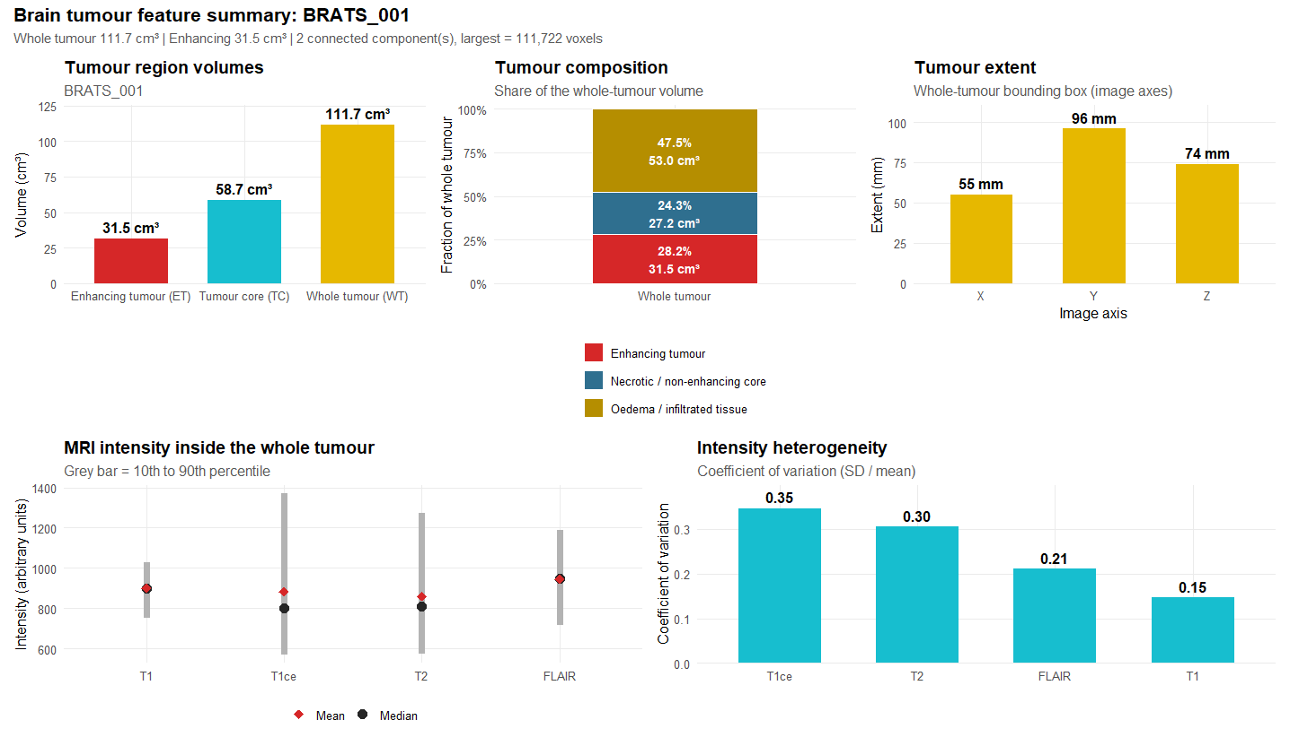
Feature Extraction
STEP THREE: |

Slide 15
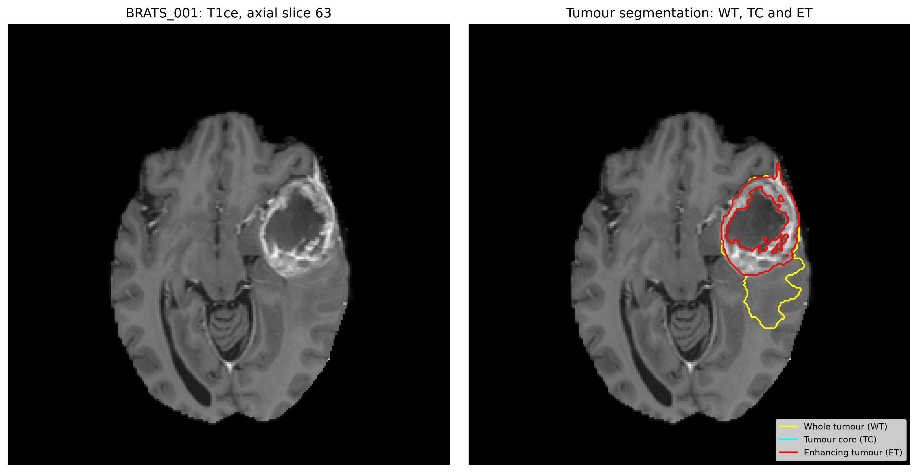
Feature Segmentation
STEP THREE: |

Slide 16
Image Segmentation and Feature Extraction
STEP THREE: |
Intuition:
T1ce [T1-Weighted Contrast Enhanced Region] surrounding dark necrotic center indicates suspected high-grade glioma, but not conclusively.
Other conditions e.g. Abscess, Metastasis and Lymphoma can produce similar results when imaged.
Histological and Molecular tests are necessary for a conclusive diagnosis.
COMPUTATIONAL MEDICINE | HIGH GRADE GLIOMA SURGICAL PLANNING

Slide 17
Image Segmentation and Feature Extraction
STEP THREE: |
Contribution of Analysis to Surgical Planning:
Enhancing volume is baseline for extent of surgical resection. It has prognostic importance.
Large necrotic core is non-diagnostic. Active rim must be targeted.
Size of tumour raises perioperative risks which need closer attention the to patient
Location of tumour guides neurosurgical team on pre-operative checks to minimize unacceptable functional impairment to patient.
COMPUTATIONAL MEDICINE | HIGH GRADE GLIOMA SURGICAL PLANNING

Slide 18
Thank You!
WE CLOSE HERE: |
COMPUTATIONAL MEDICINE | HIGH GRADE GLIOMA SURGICAL PLANNING

